Slide 1
Columnar Data Storage: A Deep-Dive into Parquet, Delta Parquet, Columnstore Indexes, and More!
Edward Pollack
Microsoft Data Platform MVP
Data Architect
Transfinder

Slide 2







Ed Pollack
Microsoft Data Platform MVP
Published author of:
Dynamic SQL: Applications, Performance, and Security, 2nd Edition
Analytics Optimization with Columnstore Indexes in SQL Server
Published in Expert T-SQL Functions in SQL Server, 3rd Edition
Expert Performance Indexing in SQL Server, 4th Edition
Author on SQLServerCentral, SQLShack, and Simple Talk.
Organizes:
SQL Saturday Albany (TBA: Returning soon!)
Future Data Driven
Capital Area SQL Server User Group
Speaker at many data events
Find me on: LinkedIn

Slide 3
Agenda
Brief review of OLAP vs. OLTP workloads & columnstore.
Columnstore Index compression and storage.
Parquet storage and compression.
Delta parquet storage and compression.
Vertipaq optimization / V-Order Optimization Z-Order Optimization / Liquid Clustering
Performance notes/best practices.
Take a few deep breaths.
Conclusion.

Slide 4
OLAP vs. OLTP
Transactional (OLTP) workloads are typically:
Less rows
More updates/deletes.
More columns. Columns may contain text or other binary data.
Very time-sensitive*. End users are waiting.
Limited aggregation. Detail data is important.
Analytic (OLAP) workloads are typically:
More rows.
Mostly inserts, maybe deletes, few (if any) updates.
Less columns. Columns are often numbers, dates, or lookups.
Not always time sensitive*. Waiting a bit is more acceptable.
Aggregation common. Metrics/calculations are important.

Slide 5
What About Mixed Workloads?
Log data, current/history tables, queue tables, etc…
Data is often written via inserts and rarely modified.
Or only a small portion is modified.
Data may be repetitive.
May or may not be time-sensitive*.
Data can often be partitioned into active/inactive data.
OLAP data conventions can sometimes be used (with a bit of caution).
Data lakes are a mix of OLAP and OLTP features, but are 100% OLAP for the purpose of compression/storage.

Slide 6

Columnstore Indexes in SQL Server

Slide 7
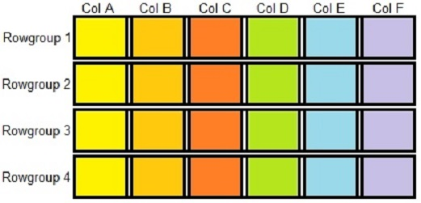
Columnstore Index Storage Format (SQL Server)
Data is stored in segments. Each contains data for one column.
Up to 2^20th rows per rowgroup
One segment per column per rowgroup
All segments, rowgroups, and metadata are stored in 8kb pages in SQL Server data files (MDF/NDF)

Slide 8
Columnstore Index Compression
Each segment is compressed separately.
1 segment = 1 column = 1 data type.
Ordered data compresses more effectively (more on this later).
Data that is “close” to other data is more similar.

Slide 9
Encoding Algorithms
Lossless algorithms to adjust how data is represented.
Common algorithms:
Bit packing
Dictionary encoding
Value encoding
Bitmap encoding
Encoding goals:
Reduce size of repeated data.
Save space
Allow for more effective compression later on.

Slide 10
Bit Packing
Excess zeroes are removed from fixed-width data types, reducing their storage footprint:
Value | SQL Data Type | Size (bits) | Binary | Bit-Packed Size
65000 | INT | 32 | 1111110111101000 | 16
10000 | INT | 32 | 10011100010000 | 14
950000 | INT | 32 | 11100111111011110000 | 20
100 | INT | 32 | 1100100 | 7
30 | INT | 32 | 11110 | 5
90 | INT | 32 | 1011010 | 7
120 | INT | 32 | 1111000 | 7
8000 | INT | 32 | 1111101000000 | 13
9580 | INT | 32 | 10010101101100 | 14
 |  | 288 |  | 108

Slide 11
Dictionary Encoding
A dictionary is a compressed hash table of reusable values.
Strings and larger data types benefit most from this.
Values are converted into dictionary lookups.
Removes the need to repeat large values over and over.
Dictionaries have a maximum size of 16MB.
This can cause rowgroup splits and reduce columnstore storage efficiency.

Slide 12
Dictionary Encoding Example
Original Data
Values | Size (bytes)
Chocolate Chip Cookie | 21
Blueberry Scone | 15
Double-Chocolate Brownie | 24
Strawberry Cake | 15
Baklava | 7
Double-Chocolate Brownie | 24
Double-Chocolate Brownie | 24
Baklava | 7
Double-Chocolate Brownie | 24
Chocolate Chip Cookie | 21
Chocolate Chip Cookie | 21
TOTAL DATA SIZE (bytes): | 203

Slide 13
Dictionary Encoding Example
Original Data
Values | Size (bytes)
Chocolate Chip Cookie | 21
Blueberry Scone | 15
Double-Chocolate Brownie | 24
Strawberry Cake | 15
Baklava | 7
Double-Chocolate Brownie | 24
Double-Chocolate Brownie | 24
Baklava | 7
Double-Chocolate Brownie | 24
Chocolate Chip Cookie | 21
Chocolate Chip Cookie | 21
TOTAL DATA SIZE (bytes): | 203
Build a dictionary lookup table
Dictionary
Index ID | String Value | Size (bytes)
0 | Chocolate Chip Cookie | 21
1 | Blueberry Scone | 15
2 | Double-Chocolate Brownie | 24
3 | Strawberry Cake | 15
4 | Baklava | 7
 | TOTAL DICTIONARY SIZE (bytes): | 82

Slide 14
Dictionary Encoding Example
Original Data
Values | Size (bytes)
Chocolate Chip Cookie | 21
Blueberry Scone | 15
Double-Chocolate Brownie | 24
Strawberry Cake | 15
Baklava | 7
Double-Chocolate Brownie | 24
Double-Chocolate Brownie | 24
Baklava | 7
Double-Chocolate Brownie | 24
Chocolate Chip Cookie | 21
Chocolate Chip Cookie | 21
TOTAL DATA SIZE (bytes): | 203
Map values to the dictionary
Dictionary Encoded Data
Index ID | Size (bits)
0 | 1
1 | 1
2 | 2
3 | 2
4 | 3
2 | 2
2 | 2
4 | 3
2 | 2
0 | 1
0 | 1
TOTAL DATA SIZE (bits): | 20
Dictionary
Index ID | String Value | Size (bytes)
0 | Chocolate Chip Cookie | 21
1 | Blueberry Scone | 15
2 | Double-Chocolate Brownie | 24
3 | Strawberry Cake | 15
4 | Baklava | 7
 | TOTAL DICTIONARY SIZE (bytes): | 82

Slide 15
Value Encoding
Mathematical manipulation to shrink footprint of numeric columns.
Values are transformed using common rules for each segment.
Dictionary and value encoding can be combined.
Can be applied to any data type that can be represented by a numeric (including dates, datetime, etc…).

Slide 16
Value Encoding Example #1
Value | Min Size in bits
65000 | 16
10000 | 14
950000 | 20
100 | 7
30 | 5
90 | 7
120 | 7
8000 | 13
9580 | 14
 | 103
Value | Value * 10⁻¹ | Min Size in bits
65000 | 6500 | 13
10000 | 1000 | 10
950000 | 95000 | 17
100 | 10 | 4
30 | 3 | 2
90 | 9 | 4
120 | 12 | 4
8000 | 800 | 10
9580 | 958 | 10
 |  | 74
Pick a common divisor (magnitude)
Magnitude = 10⁻¹
Divide values by the common divisor

Slide 17
Value Encoding Example #2
Value | Min Size in bits
65000 | 16
10000 | 14
950000 | 20
100 | 7
30 | 5
90 | 7
120 | 7
8000 | 13
9580 | 14
 | 103
Value | Value - 30 | Min Size in bits
65000 | 64970 | 16
10000 | 9970 | 14
950000 | 949970 | 20
100 | 70 | 7
30 | 0 | 1
90 | 60 | 6
120 | 90 | 7
8000 | 7970 | 13
9580 | 9550 | 14
 |  | 98
Pick a common base
Base = 30
Subtract the common base from
each value

Slide 18
Value Encoding Example #3
Value | Min Size in bits
1500000000 | 32
1500000001 | 32
1500000002 | 32
1500000003 | 32
1500000004 | 32
1500000005 | 32
1500000006 | 32
1500000007 | 32
1500000008 | 32
1500000009 | 32
 | 320
Pick a common base
Value | Value - 1500000000 | Min Size in bits
1500000000 | 0 | 1
1500000001 | 1 | 1
1500000002 | 2 | 2
1500000003 | 3 | 2
1500000004 | 4 | 3
1500000005 | 5 | 3
1500000006 | 6 | 3
1500000007 | 7 | 3
1500000008 | 8 | 4
1500000009 | 9 | 4
 |  | 26
Base = 1,500,000,000
Subtract the common base from
each value

Slide 19
Run-Length Encoding
Finds repeated values and byte patterns and summarizes them.
Is significantly more effective on repetitive, sorted* data.
Value | Bit-Packed Size (bits)
5 | 3
5 | 3
5 | 3
5 | 3
4 | 3
4 | 3
3 | 2
1 | 1
2 | 2
3 | 2
3 | 2
2 | 2
1 | 1
Total: | 30
Value | Repetitions | Size
5 | 4 | 6
4 | 2 | 5
3 | 1 | 3
1 | 1 | 2
2 | 1 | 3
3 | 2 | 4
2 | 1 | 3
1 | 1 | 2
 | Total: | 28
Aggregate Values

Slide 20
Columnstore Compression
SQL Server uses the Microsoft xVelocity algorithm for Columnstore compression
SQL Server uses the Microsoft Xpress algorithm for Columnstore archive compression.
Both columnstore compression algorithms use at least bit-packing and run-length encoding. Other algorithms are used situationally.

Slide 21
Vertipaq Optimization
Within each rowgroup, row order does not matter!
After segments are encoded, but prior to final compression algorithms are applied, rows are re-ordered.
Goal is for similar values to be grouped together in the segments that would benefit most from run-length encoding.
This is expensive, but greatly improves compression ratios.
Some scenarios prevent Vertipaq optimization from being applied to new data:
Delta rowgroup data merged into clustered columnstore w/ non-clustered rowstore index(es).
Memory-optimized columnstore indexes.

Slide 22
Vertipaq Optimization Example
Optimization does not save space, but sets up data
so that compression is far more effective later.
Dictionary Encoded Data
Index ID | Size (bits)
0 | 1
1 | 1
2 | 2
3 | 2
4 | 3
2 | 2
2 | 2
4 | 3
2 | 2
0 | 1
0 | 1
TOTAL DATA SIZE (bits): | 20
Optimized Data
Index ID | Size (bits)
0 | 1
0 | 1
0 | 1
1 | 1
2 | 2
2 | 2
2 | 2
2 | 2
3 | 2
4 | 3
4 | 3
TOTAL DATA SIZE (bits): | 20
Re-order values

Slide 23
Metadata
Metadata about each segment and Rowgroup is stored centrally.
Includes min, max, count, NULLability, and more.
Facilitates segment/Rowgroup elimination and faster filtering.
Data order is CRITICAL to this!
Exposed via dynamic management views
sys.column_store_rowgroups
sys.column_store_segments
sys.column_store_dictionaries
And more!

Slide 24
Data Order
Ordered data compresses far better than unordered data.
Order by most common filter. This is often a date/datetime dimension
Data often naturally orders by date.
If order is disrupted heavily by maintenance/releases, consider a rebuild.
Clustered rowstore index on unordered data by key data order column.
Replace with clustered columnstore on newly ordered data.
If older data is inactive/read-only, it can be ordered and left alone.
Forever ☺
Partitioning makes this easy.

Slide 25
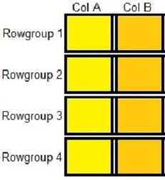
Segment Elimination
Only query for Col A & Col B
Unneeded columns are automatically skipped

Slide 26

Rowgroup Elimination
Query for a small date range
and rowgroups outside of that
Range are ignored.
***Requires ordered data***

Slide 27

Segment and Rowgroup Elimination
Query for a small date range
AND for only Col A & Col B

Slide 28
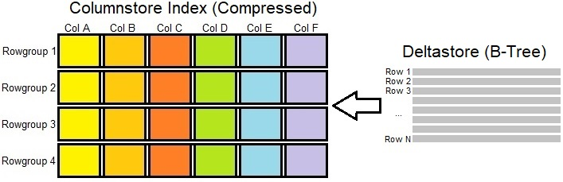
Writing to Columnstore Indexes
Compressing rowgroups is expensive. The delta store accumulates smaller batches
of write operations and processes them in bulk asynchronously. Read queries
interrogate both compressed rowgroups and the deltastore to retrieve result sets.

Slide 29
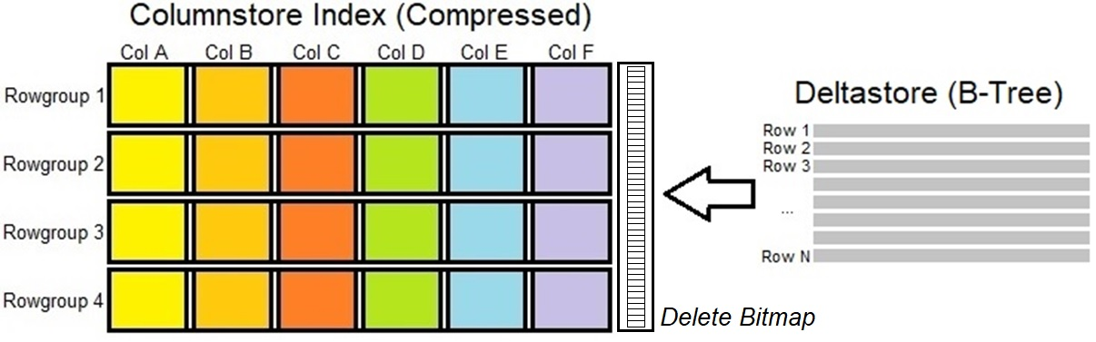
Writing to Columnstore Indexes
The delete bitmap overlays each rowgroup, indicating which rows are deleted. Delete bitmaps are only created when deleted rows exist. Deletes are soft-deletes.

Slide 30
Apache Parquet

Slide 31
Apache Parquet File Format
An open format that has been adopted by many platforms.
Open = portable! No vendor lock-in!
Column-based storage.
Many similarities to columnstore index conventions.
(MUCH) more efficient for analytics than other file formats (CSV, XML, JSON, etc…)

Slide 32
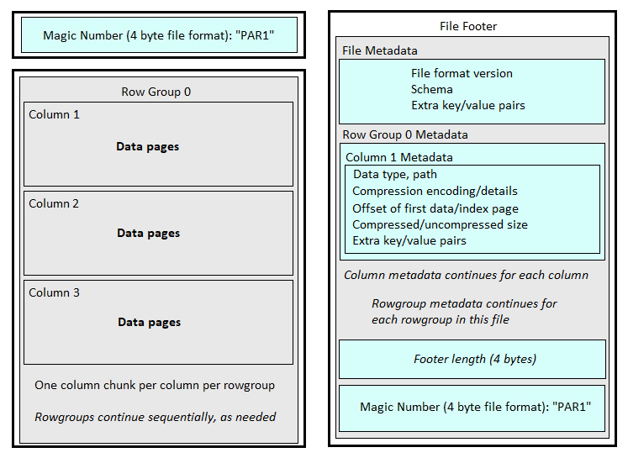
Apache Parquet File Format Details
Within each Rowgroup, each column’s
data is referred to as a “Column Chunk”
Each column chunk can be divided into
as many pages as is needed to store
its data.
Each data page contains a header with
metadata describing its contents.

Slide 33
Apache Parquet File Format Notes
Like columnstore indexes, metadata is separated from data, though it does not provide the same optimizations as columnstore (yet!)
Data page defaults to approximate 1MB max size. This can be customized if needed.
Via write_table() option data_page_size.
Data types are extrapolated into smaller/simpler types.
For example, strings become binary byte arrays.
Minimum unit of reads is the column chunk.

Slide 34
Apache Parquet Compression
Spark supports many different algorithms/formats:
Snappy, gzip, lzo, brotli, lz4, zstd, and uncompressed.
Parquet uses many familiar encoding methods:
Run-length encoding
NULLs are removed via run-length encoding.
Dictionary encoding
Bit-packing
Compression is applied at the page level. This means that each column chunk can contain data compressed in different ways (by page).

Slide 35
Delta Encoding
Additional encoding type available to the Parquet format.
Computes the difference between consecutive values and stores that difference (delta).
Effective on values that span a small range, especially large values.
This has absolutely nothing to do with Delta Lake.

Slide 36
Delta Encoding Example
Value | Bit-Packed Size (bits)
1000 | 10
1000 | 10
1001 | 10
1003 | 10
1005 | 10
1006 | 10
1006 | 10
1007 | 10
1008 | 10
1009 | 10
1015 | 10
1020 | 10
1025 | 11
Total: | 131
Delta | Bit-Packed Size (bits)
1000 | 10
0 | 1
1 | 1
2 | 2
2 | 2
1 | 1
0 | 1
1 | 1
1 | 1
1 | 1
6 | 3
5 | 3
5 | 3
Total: | 30

Slide 37
Delta Lake

Slide 38
Delta Lake
Is a set of versioned Parquet files with a transaction log.
Allows for concurrent writes, time travel, and versioning.
Provides ACID transaction capabilities via optimistic snapshot isolation.
Consumes more space and can become fragmented with lots of updates. Similar challenge to columnstore indexes w/ updates.
Ideal workloads are mainly insert/read, maybe deletes, no updates.
Metadata is stored inline with data to prevent the metadata store from becoming prohibitively large.
Changes are referred to as Commits.
Open source format
Open = portable! No vendor lock-in!

Slide 39
Delta Lake Components
Data Files
Details of data modified during the transaction
Stored in a parquet file (*.parquet)
Deletion Vector Files
References deleted rows that are to be soft-deleted (like the delete bitmap)
Stored as a binary file (*.bin)
Change Data Files
Manages data changes only: UPDATE, DELETE, MERGE.
Stored as parquet file (*.snappy.parquet)

Slide 40
Delta Lake Components
Delta Log Entries
Log of all changes to a table. Each log file is a unit of atomicity for the table.
Stored as a JSON (*.json)
Checkpoints
Contains a complete replay of all actions on a table.
May follow two distinct file conventions: V1 spec & V2 spec:
V1 spec are flat checkpoints stored in numbered parquet files.
Single-file checkpoints are more reliable than multi-file, which are deprecated.
V2 spec use a JSON file and any number of sidecar parquet files (or none)
File adds/removes go in sidecar files, if needed.
Compaction
For entities that are the target of many writes, the OPTIMIZE command can be used to compact many small files into a smaller number of larger files.

Slide 41
Parquet vs. Delta Lake
Parquet is ideal for:
Full or infrequent data loads (classic monthly/weekly/daily data load scenarios).
Concurrency is not a problem.
Time travel/versioning is not needed.
Delta Lake is ideal for:
ACID transaction support.
Time travel/versioning.
Frequent incremental data loads and/or streaming data.
Expected contention between readers & writers.
*Note that Delta Lake requires more compute and will cost more than using only the parquet format.

Slide 42
V-Order Optimization
Parquet file optimization found in Azure Lakehouse, Delta Lake, and Direct Lake.
Orders rows within parquet files to optimize compression.
Encoding/compression is tied directly into V-Order optimization.
Analogous to Vertipaq optimization in columnstore indexes.
Improves rowgroup read speeds.
V-ordered files remain open source/parquet format compliant.
Enabled by default in Apache Spark & Microsoft Fabric.

Slide 43
Z-Order Optimization
Data is co-located in a set of Delta Lake files.
Can be manually enabled for columns that are expected to be often used in query predicates, and that have high cardinalities.
Allows selective loading of files and/or rowgroups.
Analogous to rowgroup/segment elimination in columnstore indexes.
Can work together with V-Order optimization.
Statistics are automatically collected for up to the first 32 columns in a table. Stats are needed for Z-Order optimization to be effective.
Can be added manually, if needed.

Slide 44
Liquid Clustering
Z-Order optimization requires keys to be chosen and order to be maintained on newly inserted data (by reclustering that data)
Uses a faster method to organize data with less compute/time required to do so.
Great for data skew, inconsistent workloads, and scenarios where it is hard to predict query predicates.
Changing clustering column is faster than Z-Order Optimization.
Found in Databricks Runtime 13.3+ for Delta tables.
Row-level concurrency is in Databricks Runtime 14.2+

Slide 45
Phew! That was a LOT!

Slide 46
What About Proprietary Analytics Tools?
Tableau, Snowflake, Iceberg, Sisense, Cognos, etc…
Even if details are not available, architecture is similar.
Columnstore plus:
Supplemental indexing
Encoding/Compression
Co-locating data
Row-order optimization
Delta-like structures for ACID transactions
Metadata analytics

Slide 47
Best Practices for Analytic Data Storage
Avoid UPDATE operations. They are computationally expensive in any format and increase concurrency risks in non-ACID solutions.
Replacing with atomic DELETE/INSERT operations is a valid simplification.
Load new data in order by a frequently-queried column.
Often a datetime, such as a sample/load/log/event time.
Maintain order over time, if possible.
Consider a complete reload/re-creation of data if data is too fragmented.
Can be done by table/partition/file as needed. No need to reload everything if most is ordered.
Ordered columnstore index feature is not production-worthy. Yet.
Dig into metadata and settings and fine-tune, but only when needed.

Slide 48
Best Practices for Analytic Data Storage (Part 2)
Partition data, if able. Old data may not be used the same way as new data. Consider archived, soft-deleted, inactive, or unused data. Compress differently, if needed.
Normalize large text/strings. Especially with high cardinality.
Lengthy text/binary data does not compress as well and can cause dictionary pressure in any format that uses dictionary compression.
Query only the columns that are needed.
Reduces reads significantly and speeds up data access on any platform.
Use bulk-insert functionality, when available.
Inserting more rows at once is more efficient than trickle-loads.
Updates cannot take advantage of this on most platforms.

Slide 49
Conclusion
Knowing how analytic data is stored can help improve data load and analytics performance.
Most analytic storage engines have similar architectures.
Choosing the best tool for the job can reduce cost and improve performance.
Open-source tools carry a huge advantage if you want to avoid vendor lock-in.

Slide 50
Thank You!
Edward Pollack
@EdwardPollack
ed@edwardpollack.com
Ed Pollack | LinkedIn

